Slide 1
Hiring Process Analytics
By
Mounika Bandla

Slide 2
Project Description
Hiring process analysis is a crucial function in understanding trends such as the number of rejections, interviews, job types, and vacancies to provide valuable insights for the hiring department.
Here, we are going to handle the missing data, outliers and get a statistical summary of clean data to start the analysis.
By using visualizations, the hiring department will have meaningful insights to improve its hiring process and make better hiring decisions in future.

Slide 3
Approach
Ask:
Determining the gender distribution of hires.
What is the average salary offered by this company?
Creating class intervals for the salaries in the company.
Visualizing the proportion of people working in different departments.
Use charts or graphs to represent different position tiers within the company.

Slide 4
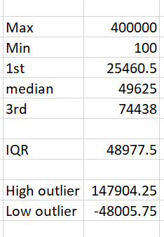
Prepare:
Collect the dataset containing the records of previous hires.
This dataset is stored as .xlsx file and contains 7 columns and 7169 data points or rows.
Columns are as follows:
application_id, Interview Taken on, Status, event_name, Department, Post Name, Offered Salary.
Have statistical measures,

Slide 5
Process: The dataset contains some errors we are going to deal with them,
Handling Missing Data: we have missing values in these columns:
event_name - we have some rows with ‘-’, I am going to replace them with ‘Don’t want to say’ which is similar and change this column to ‘Gender’ foe easy understanding.
post_name - some rows are filled with c-10 instead of c10 which is a common data entry error. So change them to c10.
post_name - we have a missing entry, it is present in row with sales department and offered salary is 85,914. So after removing outliers, the post_name c5 (129),c9(116) are more frequently occurring with respect to sales department but the average offered salary is more for c9 i.e., 50,045 so we are going to replace the blank with c9.
Offered Salary - we have other blank belonging to a male in sales department for i7 position who is rejected, so by using pivot tables we can find the average salary of males in sales department who are rejected and replace the blank with 54,971.

Slide 6
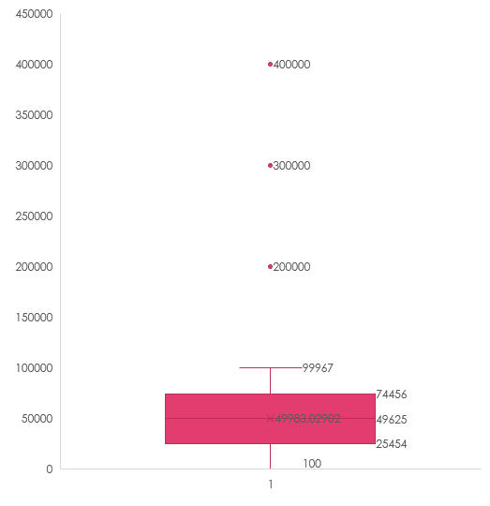
2. Clubbing columns: There are no columns that needs clubbing.
Outlier detection: I am going to use two methods for outliers detection, first through finding 1st quartile(Q1), 3rd quartile(Q3), median by QUARTILE() function. Then calculating IQR = Q3-Q1. From this I am going to get high outlier = Q3+(1.5*IQR) and low outlier= Q1-(1.5*IQR) and using OR() function the OR() returns TRUE it is a outlier.
Second way is by ’box and whisker’ chart,

Slide 7
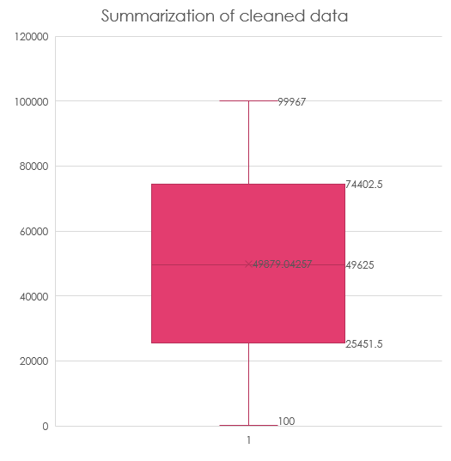
4. Removing Outliers: From ‘box ‘ plot we can see there are 4 outliers, the best strategy in this case is removing the 3 rows using the sort and filter to improve the accuracy of the our analysis. As we don’t have any father information like are there data entry error, measurement errors or such.
5. Data Summary: After cleaning the outliers and handling missing data, the data set is ready for analysis. Summarization is as follows,

Slide 8
Analyze: Finally dataset is ready for analysis and providing valuable insights for hiring department to improve its hiring process.
For excel sheet click here
Hiring Analysis: Gender distribution hired by the company.

Slide 9
B. Salary Analysis: The average salary offered by the company.
Salary analysis is by taking averages of the offered salary by the company.
The average salary offered is 49,879 for all status as well as all Gender.
The average salary of people working for the company is 49,593.

Slide 10
C. Salary Distribution: Class intervals are created based on the grouping feature of pivot table.

Slide 11
D. Departmental Analysis: Visualization to show the proportion of people working in different departments

Slide 12
E. Position Tier Analysis: Bar graph to represent the different position tiers within company.

Slide 13
Tech Stack Used
Ms Excel office 2016
A spreadsheet software where data can be stored in tabular format, cleaned and analysed to obtain meaningful insights for data-driven decisions.
Ms PowerPoint 2016
A powerful presentation maker used to create slideshow of valuable information through charts, and images.

Slide 14
Insights
Share and Act: After analysing the data we have to share our findings with hiring department.
They are 708 males more than females currently working in the company.
Average salary offered is 49,879 while average salary for people working in the company is 49,593. Irrespective of Gender.
Most people are hired for the company have middle range salaries. They are 779 employees with salary between 40100 - 50099. while the least number of hired people is for high salary range which is only 649 people with salary between 90100 – 100099.
About 39% of hired candidates are for operations department. While the least hired candidates with 2% are for Human Resource department followed closely by general management department with 3% and finance department with 4%.
c9 is the most hired position across all departments with 1240 candidates while n6, m6 are least hired with only 1, 2 candidates respectively.

Slide 15
Result
In this project, we have successfully performed hiring analysis, salary analysis, salary distribution analysis, departmental analysis, position tier analysis and provides valuable insights to the hiring department to improve its hiring process in the future.

